Slide 1

Amazon Laptops Price prediction
Presented by
Nada alruwaythi
Nisreen alsayegh

Slide 2
OUTLINE
- Introduction
- Workflow
- Data
- Design
- Tools
- EDA-Analysis
- Models
- Conclusion

Slide 3
Introduction
Amazon represents one of the largest marketplaces on the Internet. People use its services on a daily basis to order groceries, books, laptops, and even web hosting services.
Goals :
The model predicts the price of the laptop

Slide 4
Workflow
Web Scraping
EDA
Building Models
Testing Model

Slide 5
TWO Week PLAN
Choose a website
Web scraping
Clean & explore
2021
11
12
13
17
October
14
15
16
2021
18
19
20
21
22
23
October
Build Model
Test Model
Save Model
Deliver to client
Dec 20XX

Slide 6
Scraped Data
We scrap around 500 pages from amazon.com
then we marge it with the dataset in Kaggle at the end the total become 1747 rows and 11 columns.
Data Features:
Processor Speed | Processor Brand | Standing screen display size | Brand
Graphics Chipset Brand | Hard Disk Description | Hard Drive Size | RAM Size
 | Price | Item Weight | Operating System

Slide 7
Data Cleaning
Exploring Data
Cleaning Data
Explore data after merging both datasets
By removing Null and Duplicate values
Before :row1681,columns11
After dummies:
row 1681 ,columns 62

Slide 8
Tools
BeautifulSoup
Matplotlib, Seaborn
Pandas, Mito
Collect data from website
Explore & clean data
Visualise data and models
Excel
sklearn
Flask
Download data as csv file
Models training
build a web application

Slide 9
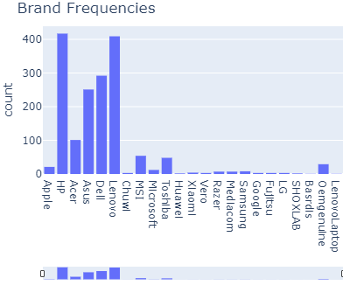
EDA - Analysis

Slide 10
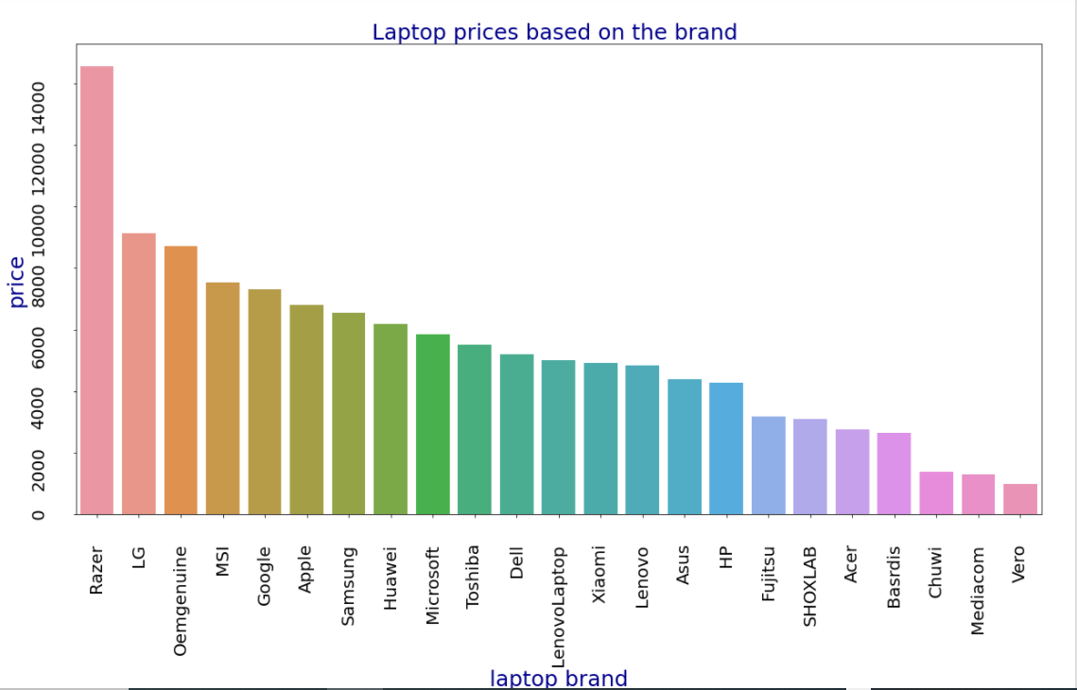
EDA - Analysis

Slide 11
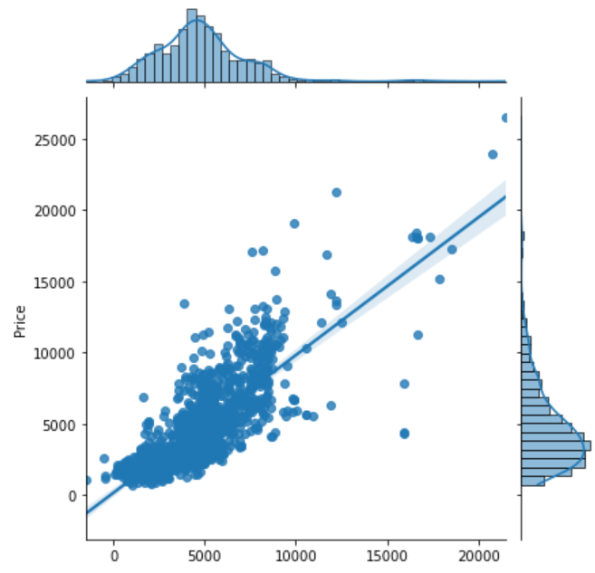
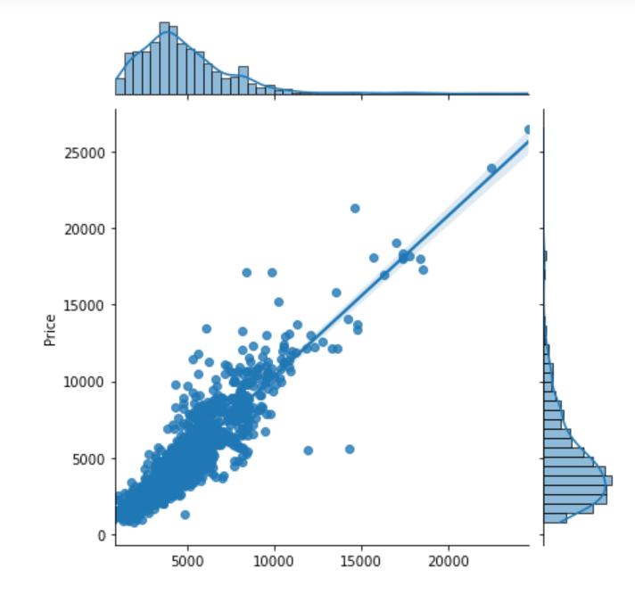
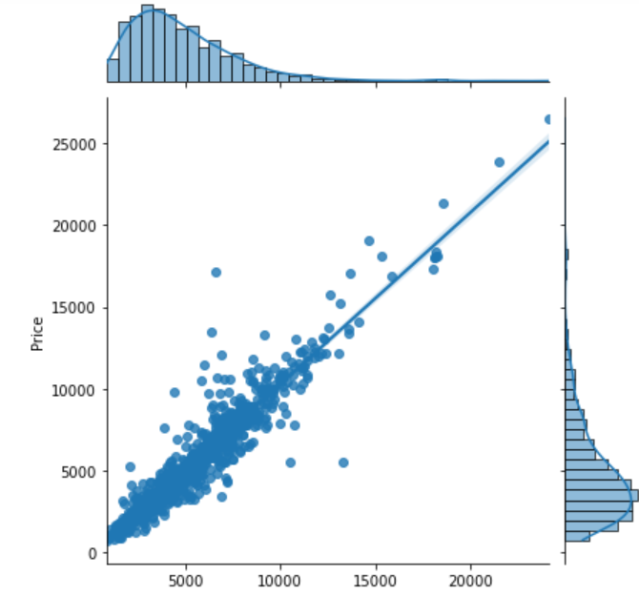
Models
Linear Regression
Gradient Boosting Regressor
Forest Regressor
Linear Regression train R^2:0.646
Linear Regression validation R^2: 0.582
Gradient Boosting Regressor train R^2: 0.865
Gradient Boosting Regressor validation R^2: 0.710
Forest Regressor train R^2:0.954
Forest Regressor validation R^2: 0.738

Slide 12
The BEST Models
CONTOSO
Random Forest Regressor Train R^2: 0.954
Random Forest Regressor Validation R^2: 0.738
After apply feature engineering : 0.948
Random Forest Regressor Test R^2 : 0.834
Gradient Boosting Regressor Train R^2: 0.861
Gradient Boosting Regressor Validation R^2: 0.706
After apply feature engineering : 0.865
Gradient Boosting Regressor Test R^2 : 0.810
A
CONVENIENT
EXPENSIVE
AFFORDABLE
D
C
E
INCONVENIENT
B

Slide 13
summary
Linear Regression | Forest Regression | Gradient Boosting | Polynomial | Lasso | Ridge | ElasticNet
0.646 | 0.954 | 0.862 | 0.865 | 0.626 | 0.626 | 0.626 | Training
0.582 | 0.738 | 0.710 | -26*10^12 | 0.534 | 0.534 | 0.534 | validation
 | 0.948 | 0.865 |  |  |  |  | Feature engineering-Training
 | 0.723 | 0.710 |  |  |  |  | Feature engineering- validation
 | 0.834 | 0.803 |  | 0.543 | 0.545 | 0.559 | Testing

Slide 14
Conclusion
After building different models Random Forest Regressor has the highest r^2 in both validation stage and testing stage removing unneeded columns has increased r^2 in Gradient Boosting Regressor but not in Random Forest Regressor .

Slide 15
Future work
- Collect and scrap more data
- Scrap data form other website
- Explore different models

Slide 16
THANK YOU
Nada alruwaythi
Nisreen alsayegh

